Slide 1
Placement management system
Presented By:
Satyam Singh
Neha Sahu
Priyanshi Srivastava
Mukesh Kumar Sahu

Slide 2
Problem statement
Background: As on today, in our country we are not having any master data base regarding campus placement in technical institute and universities throughout the country. By mapping the entire placement details throughout the county, the percentage of un-employability can be identified in various fields of education. This will help the policy makers to come out with appropriate solution through framing of policies for tackling the unemployability in the country. Provision of common platform in which the entire data base of campus placement of all technical institutes/ universities throughout the country by interlinking it will be extremely useful for the following:
1. Government/policy makers to come out with appropriate solutions.
2. Corporates to have access to the students through a central database summary: an integrated platform should be developed where in all the universities/colleges can share the resources for campus placement and the corporates can also access this database for recruiting students for the available vacancies.
Objective: To develop an inter-linked platform for campus placement in higher educational institutions of India"

Slide 3
ENROLLED -3392834 PLACEMENT – 76183
ENGINEERING STUDENT
2018- 2019
And the most interesting part is that this placement statistic is the highest that’s been in seven whole years.

Slide 4
We have many platform to get job and search job all over country like
LinkedIn – It is the world’s largest professionals network on the internet . We can use LinkedIn to find the right job or internship, connect and strengthen professional relationships etc.

Slide 5
Problem faced by many students:
1. In many colleges (Tier – 3) does not have dedicated training and placement cell. As a result many deserving students does not get opportunities to get hired by multinational companies.
Solution- We provide a interface so that recruiter can directly contact to those student.
2.In general students have to go to various web site for applying job . And fill various forms . Which is very hectic .
Solution – our website

Slide 6
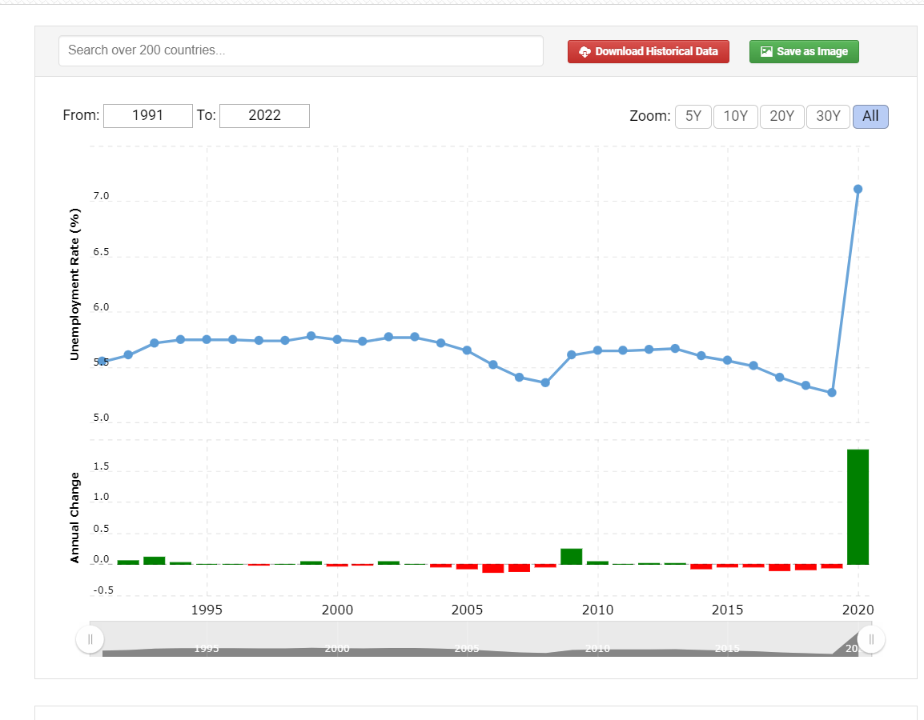

Slide 7
Objective on training placement management system:
1. The main objective of the project on placement management system is to manage the details of training, placement, company, colleges, registration.
2. The project is totally built at administrative end and thus only the administrator is guaranteed the access.
3. The purpose of the project is to build an application program to reduce the manual work for managing the training, placement, users, company. It tracks all the details about the company, colleges, registration.
4. This system is designed for the particular need of the company to carry out operations in a smooth and effective manner.
5. Basically the project describes how to manage for good performance and better services for the clients.
6. It will help a person to know the management of passed year perfectly and vividly.

Slide 8
Functionalities provided by training and placement management system are as follows:
1. Provides the searching facilities based on various factors such as training, company, colleges, registration.
2. Training and placement management system also manage the users details online for colleges details, registration details, training.
3. Manages the information of colleges.
4. Integration of all records of registration.
5. Shows the information and description of training, company.
6. Editing, adding and updating of records is improved which results in proper resource management of training data.

